Slide 1
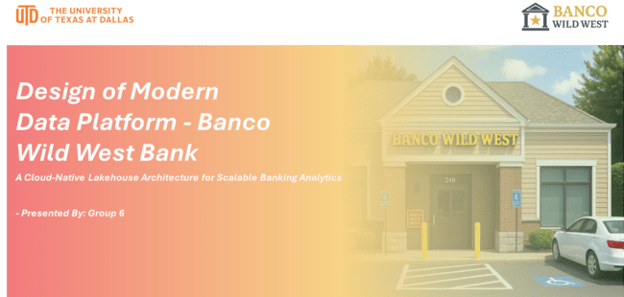
Notes:
hello

Slide 2


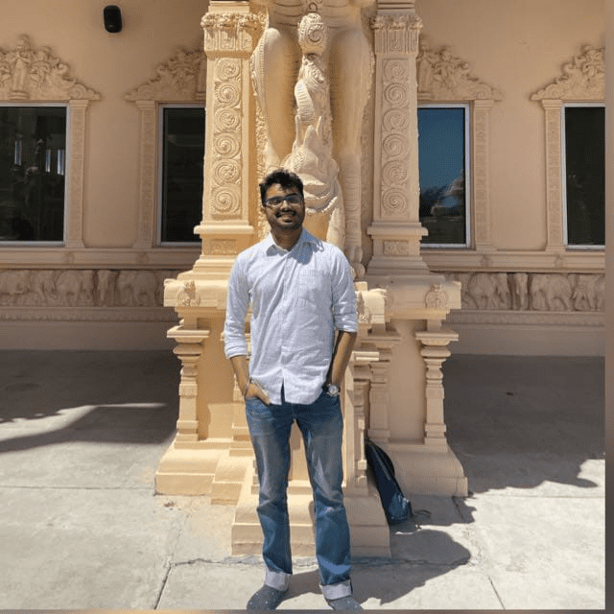
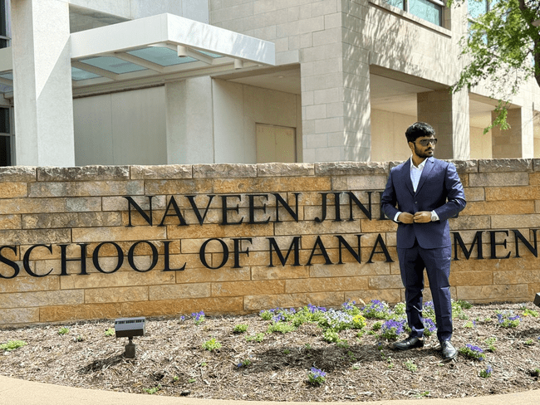



Team Member
Aditya Patil MSBA Program AXP230248@utdallas.edu
Aravind Giri MSBA Program
axg240022@utdallas.edu
Aaditya Kulkarni MSBA Program axk230255@utdallas.edu
Harish Kumar Sarathi MSBA Program HXS230100@utdallas.edu
Keerthana Ganapathi Raman MSBA Program kxg240005@utdallas.edu
Anirudh Raghavendra MSBA Program AXR230097@utdallas.edu
Hena Patel MSBA Program
hxp240013@utdallas.edu

Slide 3
Agenda
Background & Challenges Understand the current state of Banco Wild West and the need for modernization.
Goals & Requirements Define what the future platform must achieve — from AI-readiness to compliance.
Proposed Architecture Walk through the conceptual and phased AWS-based solution.
Implementation Roadmap Phased plan for building and deploying the solution.
Core Capabilities Deep dive into storage, data lake strategy, processing models, and AI/ML readiness.
Business Impact Demonstrate how this architecture drives agility, intelligence, and cost efficiency.
Closing & Next Steps Summarize key takeaways and open for discussion.

Slide 4
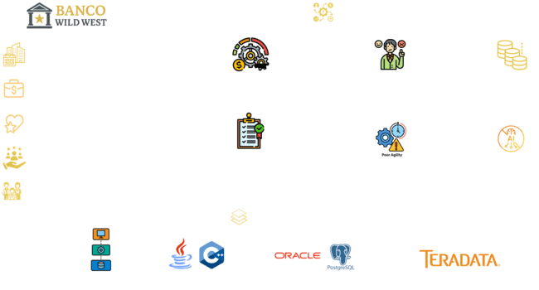
Why Banco Wild West Must Modernize: Business Gaps & Technical Barriers

Slide 5
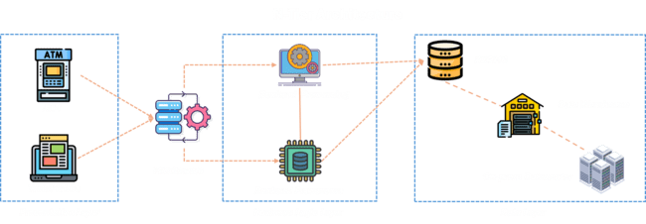

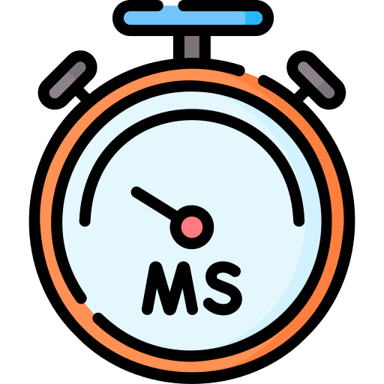

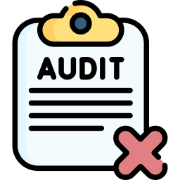


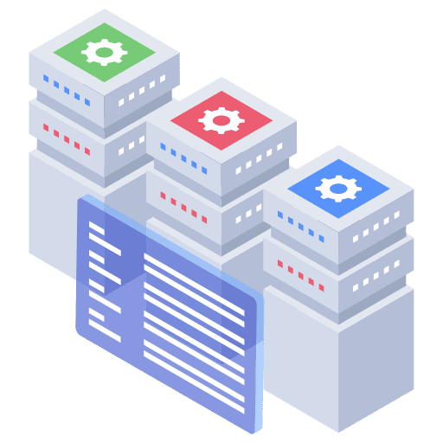

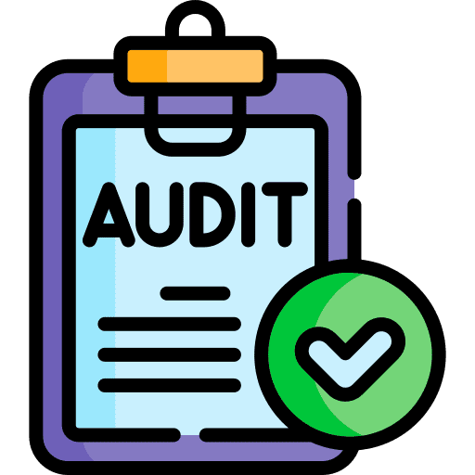



Current Data Architecture
Major Challenge
Requirement
Data Latency
Batch Dependency
Poor Auditability
Cost Efficiency
Cloud Native
Unified Data Store
Machine Learning Enablement
Auditability & Data Lineage
No Unified Schema
No support for unstructured
No Real-Time Ingestion

Slide 6

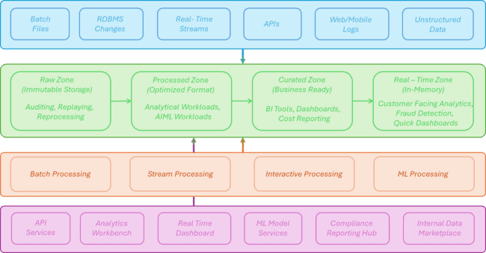
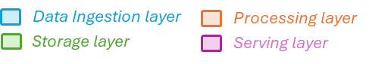
Proposed Solution - Conceptual Modern Data Platform

Slide 7

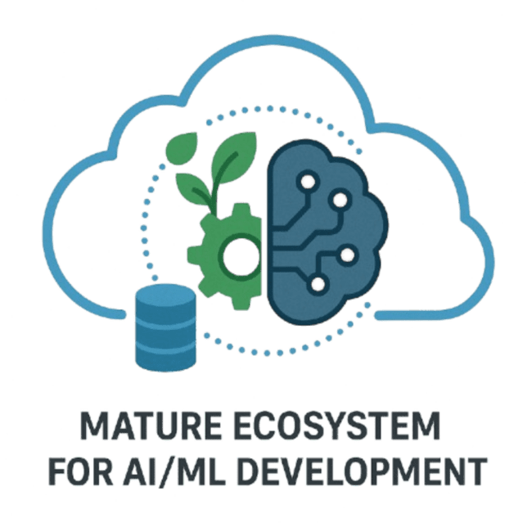
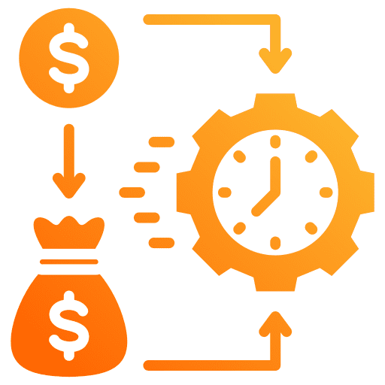








Implementation Roadmap
Choice of Cloud Environment
Regulatory & Security Compliance
Mature Ecosystem for Data & AI/ML
Cost Efficiency
Enterprise Connectivity
Scalability & Future-Proofing
Implementation Plan
Phase 1: Data Migration
Phase 2: AIML Implementation

Slide 8
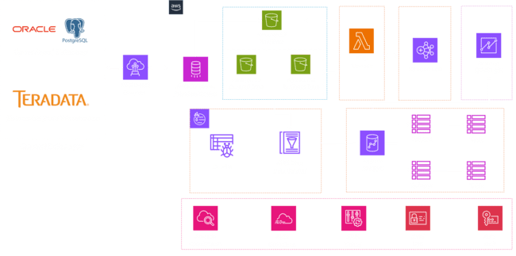
Proposed Data Architecture – Phase 1

Slide 9

Proposed Data Architecture – Phase 2
Proposed Data Architecture – Phase 2

Slide 10
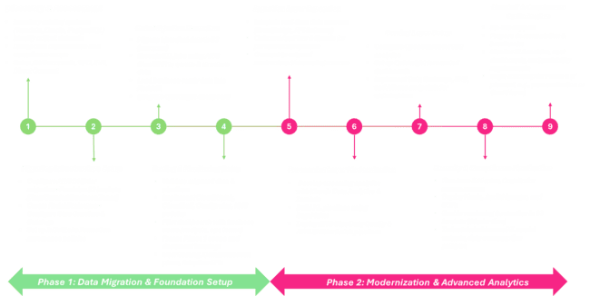
Detailed Roadmap

Slide 11

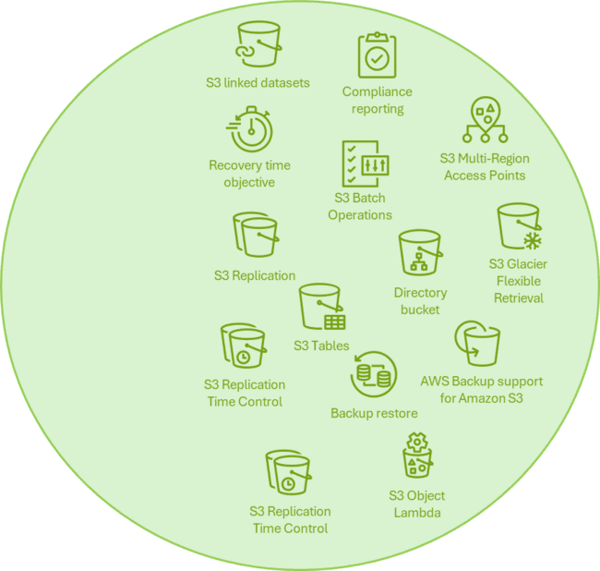
Storage Layer – Durable, Tiered & Cost-Effective (Amazon S3)

Slide 12
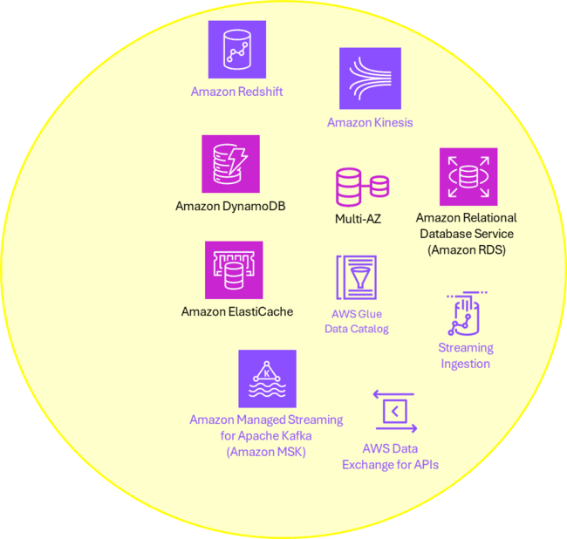

Centralized Data Lake – Unified, Scalable, OLTP+OLAP Ready

Slide 13
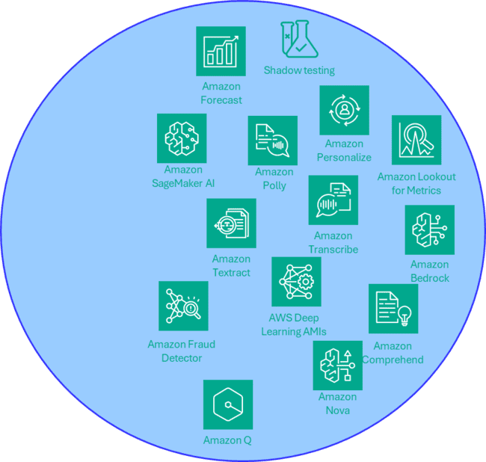

AIML Use Cases – Intelligent Banking Powered by Our Architecture

Slide 14
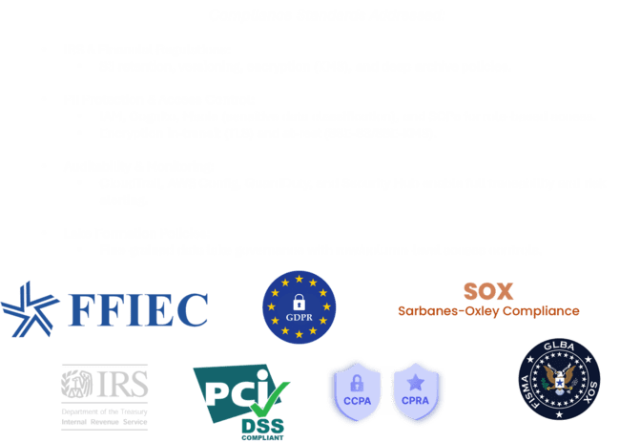
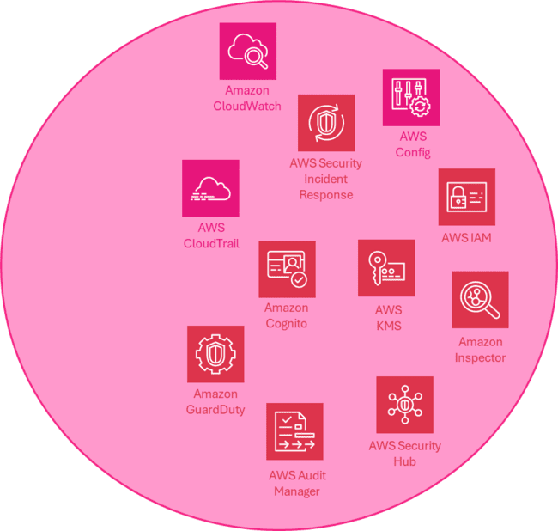
Security, Compliance & Governance – Built for Regulatory Trust

Slide 15


Business Goals & Impact – Data-Driven, Scalable, Customer-Centric
Strategic Goals Achieved
Impact Highlights

Slide 16
THANK YOU

